Slide 1
The Articles of Association
Scavenger Hunt For Young Historians

Slide 2
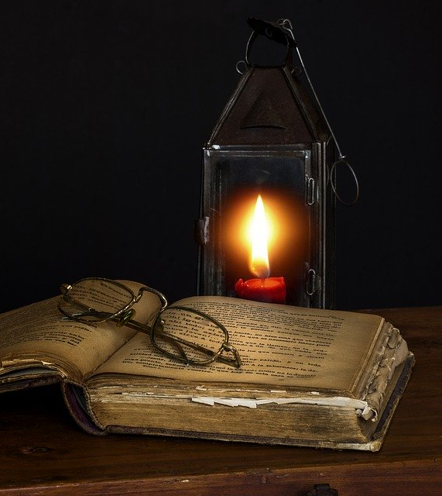
What You Will Discover
Why it was written
Why they wrote it
Who were the authors
Where did they write the document
What did they hope to accomplish
Topics you still discuss today

Slide 3
Scavenger Guide to Success
Scavenger map is the “Articles of Association” document
Clues can be found within the authors’ written words in the document
Can you hear our Patriot ancestor’s voice whispering you the answers to the selected questions?
For each correct answer you will earn a quill pen
Opportunities to challenge and discuss answers are always welcome without any loss of quill pens

Slide 4
Document Clue # 1
Start in the beginning where all great authors pick up their quill pen and ink and begin to tell a story
Fact: This document was written by hand on parchment made from untanned animal hides

Slide 5
The Articles of Association Oct. 20, 1774

Slide 6
Journals of the Continental Congress: Articles of Association
“We his majesty’s most loyal subjects the delegates of the several colonies of New Hampshire, Massachusetts-Bay, Rhode-Island, Connecticut, New-York, New Jersey, Pennsylvania, the lower counties of Newcastle, Kent and Sussex on Delaware, Maryland, Virginia, North-Carolina, and South-Carolina, deputed to represent them in a continental Congress…”

Slide 7
Who Wrote This Document ?
A British Parliament members living in the
thirteen colonies
B Soldiers and militia from a military regiment
C British colonial subjects selected as delegates
representing the thirteen colonies at a continental
Congress

Slide 8
Are all Thirteen Colonies Represented ?
A Yes, all thirteen colonies sent a delegate to the
First Continental Congress
B No, Georgia did not send a delegate because they
needed the help of British soldiers and didn’t want to
anger them
C Congress delegates didn’t have an accurate record of
who attended the First Continental Congress

Slide 9
Thirteen Colonies in 1775

Slide 10
Journals of the Continental Congress: Articles of Association
“…held in the city of Philadelphia, on the 5th day of September 1774, avowing our allegiance to his majesty, our affection and regard for our fellow-subjects in Great-Britain and elsewhere….”

Slide 11
Where was the Continental Congress held ?
A The First Continental Congress was held at the Sons of the
American Revolution Headquarters in Kentucky.
B The First Continental Congress was held at George
Washington’s Mount Vernon home
C Continental Congress was held at Carpenters Hall in
Philadelphia

Slide 12
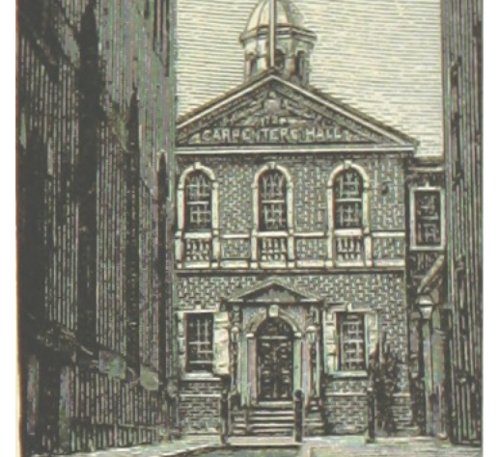
Where The Articles of Association were written
The First Continental Congress met at Carpenters Hall in Philadelphia

Slide 13
What did the delegates mean by “Great-Britain and elsewhere?
A Delegates felt great affection and respect for any
person who liked King George III of Great-Britain
B Delegates, as British subjects, felt great affection and respect
for other British subjects living in Great Britain and the British
colonies of Ireland and the West Indies
C Delegates felt great affection and respect for those
attending other colonial meetings

Slide 14
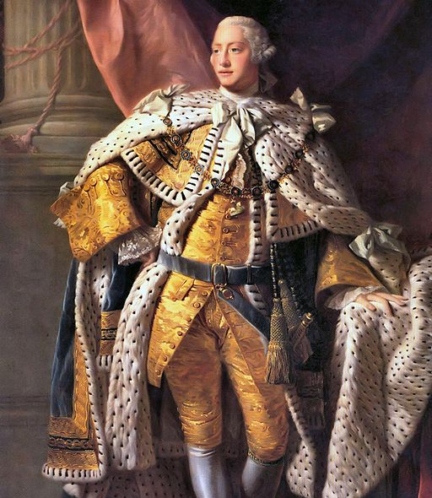
King of Great Britain George William Frederick III
George III was also King of Ireland

Slide 15
Quill Pen Tally
How many quill pens have you put into your inkwell after answering the last four questions? Each accurate answer receives one quill pen.
Fact: Do you know that the word “penna” in Latin means feather? When you ask for a pen today it is much like asking for a quill in colonial times!

Slide 16
What We Have Discovered
Who Wrote the Document and where did they meet
British colonists selected as delegates representing the thirteen colonies at a continental Congress
What Colonies were represented at the first Continental Congress
Georgia did not send a delegate because they needed the help of British soldiers
Why the delegates recognized Great Britain and elsewhere
Delegates, as British subjects, felt great affection and respect for other British subjects living in Great Britain and the British colonies of Ireland and West Indies

Slide 17
Document Clue # 2
The choice of a word can tell the reader how the authors feel. Look closely, do you see the word “anxiety,” “grievances,” “unhappy?”
Fact: Quill feathers were chosen from young birds in the Spring. Writers used swan and goose quills while crow feathers created fine lines

Slide 18
Journals of the Continental Congress: The Articles of Association
“”affected with the deepest anxiety, and most alarming apprehensions, at those grievances and distresses, with which his Majesty’s American subjects are oppressed…”

Slide 19
How do the colonists currently feel about life in the thirteen colonies?
A Colonists were tired and wanted King George III to stop
making them work so hard
B Colonists were worried about who won the last election
in Parliament
C Colonists were sad, angry and confused that as loyal
British subjects Parliament was treating them so badly

Slide 20
British Parliament

Slide 21
Journals of the Continental Congress: The Articles of Association
…”the state of the whole continent, find, that the present unhappy situation of our affairs is occasioned by a ruinous system of colony administration, adopted by the British ministry about the year 1763, evidently calculated for enslaving these colonies, and, with them, the British Empire.”

Slide 22
What do the Colonists think might happen to them in America?
A Colonists were worried that their rights and those of other
British citizens would be taken away
B Colonists will be forced to leave their homes and go back
to England.
C Colonists will not be allowed to talk to officials that live in
England

Slide 23
Document Clue # 3
Colonists think “acts” taken by Parliament make their life dangerous. What has put Colonists in danger?
Fact: Quill pens need to be sharpened to prepare them for writing. Colonists used a “penknife,” a word still in use today

Slide 24
Journals of the Continental Congress: The Articles of Association
“Various acts of parliament have been passed, for raising a revenue in America, for depriving the American subjects, in many instances, of the constitutional trial by jury, exposing their lives to danger, by directing a new and illegal trial beyond the seas, for crimes alleged to have been committed in America:”

Slide 25
What did the British ministry do to make the colonists feel this way?
A Great Britain raised taxes without the colonies being
made a part of the decision
B Allowed British officials who had been charged with
major crimes to be sent to another colony or to England
for trial rather than where the crime occurred
C All of the above and more

Slide 26
Document Clue # 4
Were the colonists planning on moving? Where were they headed: north, south, east or western frontiers?
Fact: Scribes & stationers sharpened and slit the quill point (nib) for writing. This was the origin of today’s word “Stationary”

Slide 27
Journals of the Continental Congress: The Articles of Association
“…. Several late, cruel, and oppressive acts have been passed, respecting the town of Boston and the Massachusetts-Bay, and also an act for extending the province of Quebec, so as to border on the western frontiers of these colonies, establishing an arbitrary government therein, and discouraging the settlement of British subjects in that wide extended country;”

Slide 28
What specific Acts angered the colonists?
A Parliament closed Boston Harbor and stopped all
shipping in and out of Boston (Boston Port Bill)
B The British appointed Massachusetts Governor took
away the power of locally elected officials (MA
Government Act)
C All British colonies were now required to use unoccupied
buildings to house British troops. (Quartering Act)
D All of the above

Slide 29
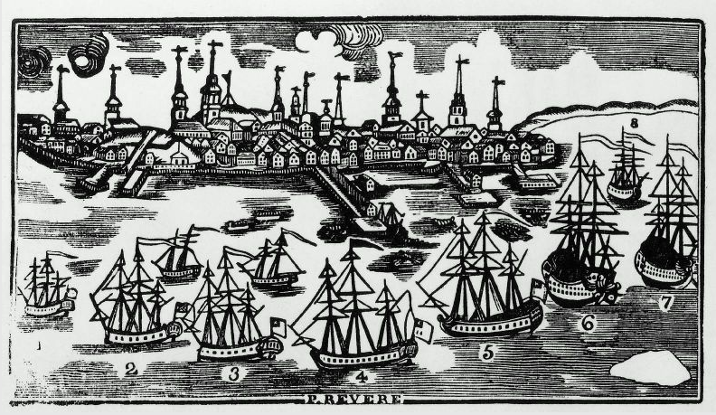
Boston Harbor
Boston harbor was the main port for exporting and importing goods and supplies in the region

Slide 30
Why did the colonists care about the province of Quebec?
A Colonists didn’t want settlers who spoke French to be
closer to the northern colonies’ borders
B By extending the province of Quebec it took away the
ability for British colonists living in the thirteen colonies to
settle in those areas.
C It would be costly for colonial businesses to redraw all of
the maps that they used for the province of Quebec

Slide 31
Quill Pen Tally
How many quill pens do you have now after the last five questions? Each accurate answer receives a quill pen.
Fact: No two quill pens are alike. Only the top three to five outer wing bird feathers are suitable for writing.

Slide 32
What We Have Discovered
How colonists felt about living in the thirteen colonies.
Colonists were sad, angry and confused about legislation that hurt how they lived in America
What might happen to the colonists in America
Colonist worried that their rights as British citizens would be taken away
Specific Acts that angered the colonists
Great Britain raised taxes and took away colonial governments’ rights to try British officials charged with major crimes
Colonists’ interests in the province of Quebec
Extending the province of Quebec no longer allowed colonists to settle on those lands

Slide 33
Document Clue # 5
Colonists have a speedy and peaceful solution to improve their lives. It requires a lot of “non” from everyone. What will be absent from their lives?
Fact: Even after the invention of metal nibs (points) for quills, quill pens remained the first choice when selecting an excellent writing tool

Slide 34
Journals of the Continental Congress: The Articles of Association
“… a non-importation, non-consumption, and a non-exportation agreement, faithfully adhered to, will prove the most speedy, effectual, and peaceable measure”

Slide 35
What does non-importation, non-consumption, and non-exportation mean to colonists?
A Colonists in the thirteen colonies will not accept (import)
goods or send (export) goods to England (except rice).
They are to avoid using British goods.
B Colonists can’t afford goods made in England, France or
Spain
C Colonists are just thinking about ways they can cut their
budgets because England is making too much money.

Slide 36
Document Clue # 6
The Articles of Association, like a letter, needs to be signed. Who signed it? Do you see some patriots that you know who didn’t sign it?
Fact: With regular use quill pens can last one to two weeks before needing additional care

Slide 37
Journals of the Continental Congress: The Articles of Association
“Therefore, we do, for ourselves, and the inhabitants of the several colonies, whom we represent, firmly agree and associate, under the sacred ties of virtue, honour and love of our country….”

Slide 38
The Articles of Association: signature page

Slide 39
Signers of The Articles of Association
The Articles of Association was signed by 53 delegates some of whom would become America’s first founding fathers
The Articles of Association was signed on October 20, 1774 in Philadelphia at Carpenters Hall by delegates of the First Continental Congress
Signatures were grouped by the colonies they represented and included Peyton Randolph, president of the First Continental Congress, George Washington, John Adams, Sam Adams and Richard Henry Lee
Signatures you will not find on the document are Benjamin Franklin, Thomas Jefferson, Alexander Hamilton and John Jay

Slide 40
George Washington by Gilbert Stuart

Slide 41
Peyton Randolph by Charles Willson Peale

Slide 42
John Adams

Slide 43
1st Article
“That from and after the first day of December next, we will not import, into British America, from great-Britain or Ireland, any goods, wares, or merchandise whatsoever, or from any other place, any such goods, wares, or merchandise, as shall have been exported from Great Britain or Ireland, nor will we, after that day, import any East-India tea from any part of the world; nor any molasses, syrups, paneles, coffee, or pimento, from the British plantations or from Dominica; nor wines from Madeira, or the Western Islands; nor foreign Indigo.”

Slide 44
What it means…
Beginning in December 1774, the colonists were putting a plan in place to financially free themselves from Great Britain and other British colonies. The Articles of Association inspired the 1776 Declaration of Independence and identified colonists’ helplessness as British subjects.

Slide 45
2nd Article
“We will neither import nor purchase, any slave imported after the first day of December next; after which time, we will wholly discontinue the slave trade, and will neither be concerned in it ourselves, nor will we hire our vessels, nor sell our commodities or manufactures to those who are concerned in it.”

Slide 47
What it means……
Beginning in December 1774 American colonists will not purchase enslaved persons from outside the thirteen colonies. The colonies will not supply ships or provide any supplies to support others in the slave trade.

Slide 48
8th Article
“We will, in our several stations, encourage frugality, economy, and industry, and promote agriculture, arts and the manufactures of this country, especially that of wool; and will discountenance and discourage every species of extravagance and dissipation, especially all horse-racing, and all kinds of games, cock fighting, exhibitions of shews, plays, and other expensive diversions and entertainments; and on the death of any relation or friend, none of us, or any of our families will go into any further mourning-dress, than a black crepe or ribbon on the arm or hat, for gentlemen, and a black ribbon and necklace for ladies, and we will discontinue the giving of gloves and scarves at funerals.”

Slide 49
What it means…
Businesses in the thirteen colonies are encouraged not to be wasteful and focus on increasing the production of wool and farm goods. The Articles of Association also identifies how colonists should behave during the boycott and discourages wasting time on expensive entertainment and clothing.

Slide 50
13th Article
“That all manufactures of this country be sold at reasonable prices, so that no undue advantage be taken of a future scarcity of goods.”

Slide 51
What this means…
All goods made within the thirteen colonies must be sold at reasonable prices even if the supply is limited. If less American goods are available for purchase due to Congress’ actions, merchants are not allowed to raise their prices on the limited merchandise. Today we could call this “price gouging.”

Slide 52
Why the Articles of Association
Before the 1776 Declaration of Independence colonists in North American were already focusing on how Parliament’s actions were harming them. The Articles of Association documented on October 20, 1774, that the colonists were angered by the Intolerable Acts and felt their rights as British subjects were being abused.
Colonists needed an organized plan that was agreed upon by the colonies represented to address their complaints against Parliament. The document’s 14 articles outlined such a plan.

Slide 53
Quill Pen Tally
Congratulations! As a young historian you have discovered the meanings behind one of our nation’s most important documents. Take these discoveries and create your own Articles of Association.
Fact: Ink for quill pens could be made using soot from burnt lamp oil mixed with glue or gum shaped into sticks and then let dry. Water could be added to a portion of the stick to create a supply of ink.

